Slide 1

Chapter 8: Project Quality Management
Information Technology Project Management, Seventh Edition
Note: See the text itself for full citations.

Slide 2
Learning Objectives
Understand the importance of project quality management for information technology (IT) products and services
Define project quality management and understand how quality relates to various aspects of IT projects
Describe quality management planning and how quality and scope management are related
Discuss the importance of quality assurance
Explain the main outputs of the quality control process

Slide 3
Learning Objectives
Understand the tools and techniques for quality control, such as the Seven Basic Tools of Quality, statistical sampling, Six Sigma, and testing
Summarize the contributions of noteworthy quality experts to modern quality management
Describe how leadership, the cost of quality, organizational influences, expectations, cultural differences, and maturity models relate to improving quality in IT projects
Discuss how software can assist in project quality management

Slide 4
The Importance of Project Quality Management
Many people joke about the poor quality of IT products (see cars and computers joke on pages 312-313)
People seem to accept systems being down occasionally or needing to reboot their PCs
But quality is very important in many IT projects

Slide 5
What Went Wrong?
In 1986, two hospital patients died after receiving fatal doses of radiation from a Therac 25 machine after a software problem caused the machine to ignore calibration data
In one of the biggest software errors in banking history, Chemical Bank mistakenly deducted about $15 million from more than 100,000 customer accounts
In August 2008, the Privacy Rights Clearinghouse stated that more than 236 million data records of U.S. residents have been exposed due to security breaches since January 2005
In March 2012, Consumer Reports listed several recalls on its Web site in less than 10 days, including LED lights overheating, five different models of cars having problems

Slide 6
What Is Project Quality?
The International Organization for Standardization (ISO) defines quality as “the degree to which a set of inherent characteristics fulfils requirements” (ISO9000:2000)
Other experts define quality based on:
Conformance to requirements: The project’s processes and products meet written specifications
Fitness for use: A product can be used as it was intended

Slide 7
What Is Project Quality Management?
Project quality management ensures that the project will satisfy the needs for which it was undertaken
Processes include:
Planning quality manasgement: Identifying which quality standards are relevant to the project and how to satisfy them; a metric is a standard of measurement
Performing quality assurance: Periodically evaluating overall project performance to ensure the project will satisfy the relevant quality standards
Performing quality control: Monitoring specific project results to ensure that they comply with the relevant quality standards

Slide 8
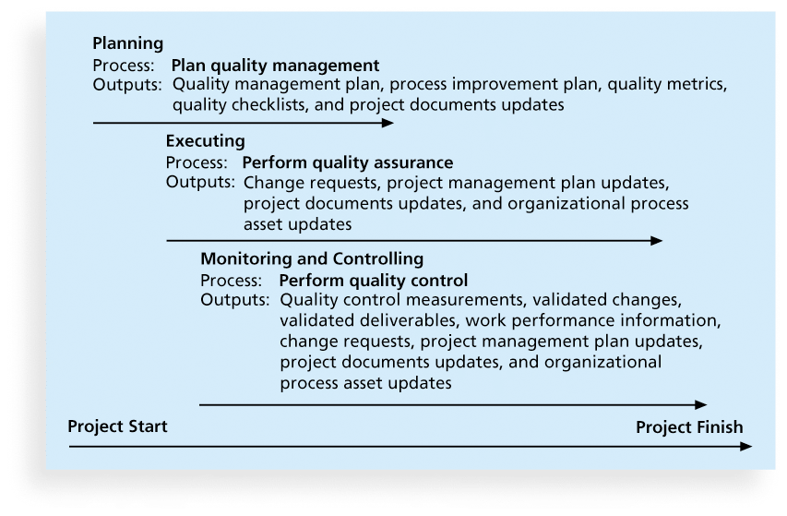
Figure 8-1. Project Quality Management Summary

Slide 9
Planning Quality
Implies the ability to anticipate situations and prepare actions to bring about the desired outcome
Important to prevent defects by:
Selecting proper materials
Training and indoctrinating people in quality
Planning a process that ensures the appropriate outcome

Slide 10
Scope Aspects of IT Projects
Functionality is the degree to which a system performs its intended function
Features are the system’s special characteristics that appeal to users
System outputs are the screens and reports the system generates
Performance addresses how well a product or service performs the customer’s intended use
Reliability is the ability of a product or service to perform as expected under normal conditions
Maintainability addresses the ease of performing maintenance on a product

Slide 11
Who’s Responsible for the Quality of Projects?
Project managers are ultimately responsible for quality management on their projects
Several organizations and references can help project managers and their teams understand quality
International Organization for Standardization (www.iso.org)
IEEE (www.ieee.org)

Slide 12
Performing Quality Assurance
Quality assurance includes all the activities related to satisfying the relevant quality standards for a project
Another goal of quality assurance is continuous quality improvement
Benchmarking generates ideas for quality improvements by comparing specific project practices or product characteristics to those of other projects or products within or outside the performing organization
A quality audit is a structured review of specific quality management activities that help identify lessons learned that could improve performance on current or future projects

Slide 13
Controlling Quality
The main outputs of quality control are:
Acceptance decisions
Rework
Process adjustments
There are Seven Basic Tools of Quality that help in performing quality control

Slide 14
Cause-and-Effect Diagrams
Cause-and-effect diagrams trace complaints about quality problems back to the responsible production operations
They help you find the root cause of a problem
Also known as fishbone or Ishikawa diagrams
Can also use the 5 whys technique where you repeated ask the question “Why” (five is a good rule of thumb) to peel away the layers of symptoms that can lead to the root cause

Slide 15
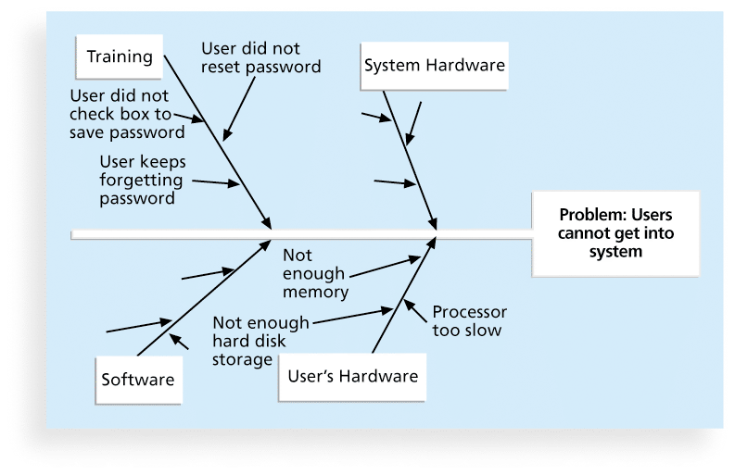
Figure 8-2. Sample Cause-and-Effect Diagram

Slide 16
Quality Control Charts
A control chart is a graphic display of data that illustrates the results of a process over time
The main use of control charts is to prevent defects, rather than to detect or reject them
Quality control charts allow you to determine whether a process is in control or out of control
When a process is in control, any variations in the results of the process are created by random events; processes that are in control do not need to be adjusted
When a process is out of control, variations in the results of the process are caused by non-random events; you need to identify the causes of those non-random events and adjust the process to correct or eliminate them

Slide 17
The Seven Run Rule
You can use quality control charts and the seven run rule to look for patterns in data
The seven run rule states that if seven data points in a row are all below the mean, above the mean, or are all increasing or decreasing, then the process needs to be examined for non-random problems

Slide 18
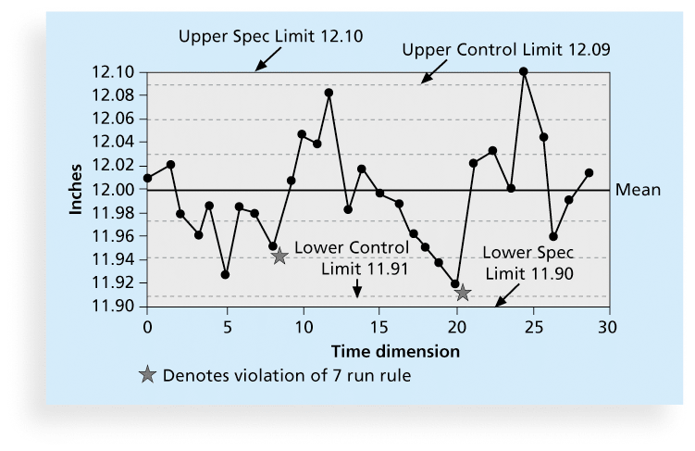
Figure 8-3. Sample Quality Control Chart

Slide 19
Checksheet
A checksheet is used to collect and analyze data
It is sometimes called a tally sheet or checklist, depending on its format
In the example in Figure 8-4, most complaints arrive via text message, and there are more complaints on Monday and Tuesday than on other days of the week
This information might be useful in improving the process for handling complaints

Slide 20
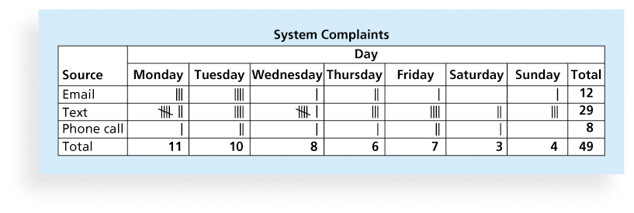
Figure 8-4. Sample Checksheet

Slide 21
Scatter diagram
A scatter diagram helps to show if there is a relationship between two variables
The closer data points are to a diagonal line, the more closely the two variables are related

Slide 22
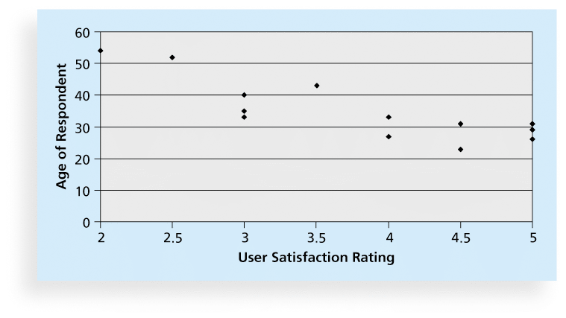
Figure 8-5. Sample Scatter Diagram

Slide 23
Histograms
A histogram is a bar graph of a distribution of variables
Each bar represents an attribute or characteristic of a problem or situation, and the height of the bar represents its frequency

Slide 24
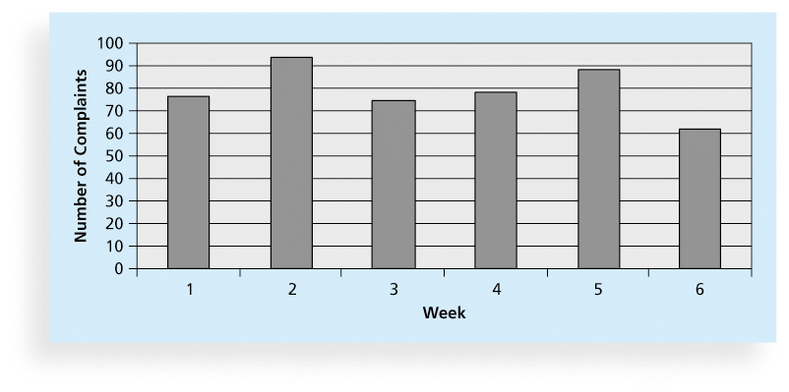
Figure 8-6. Sample Histogram

Slide 25
Pareto Charts
A Pareto chart is a histogram that can help you identify and prioritize problem areas
Pareto analysis is also called the 80-20 rule, meaning that 80 percent of problems are often due to 20 percent of the causes

Slide 26
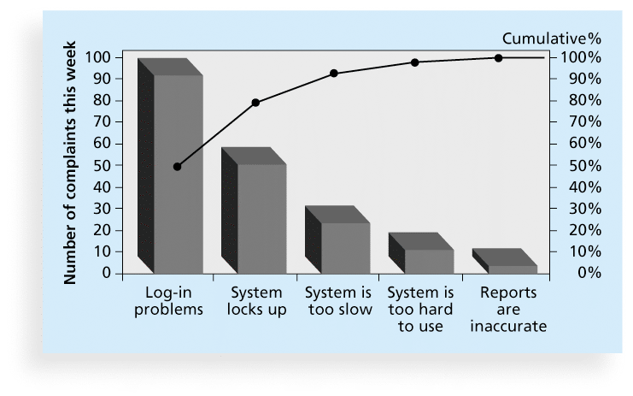
Figure 8-7. Sample Pareto Chart

Slide 27
Flowcharts
Flowcharts are graphic displays of the logic and flow of processes that help you analyze how problems occur and how processes can be improved
They show activities, decision points, and the order of how information is processed

Slide 28
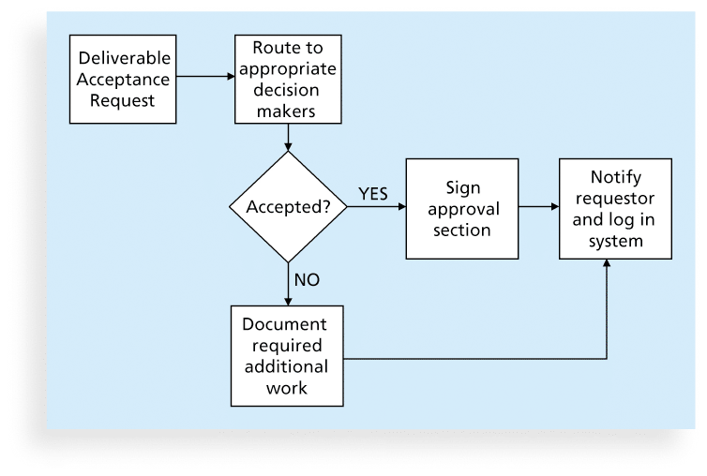
Figure 8-8. Sample Flowchart

Slide 29
Run Charts
In addition to flowcharts, run charts are also used for stratification, a technique that shows data from a variety of sources to see if a pattern emerges
A run chart displays the history and pattern of variation of a process over time.
You can use run charts to perform trend analysis and forecast future outcomes based on historical results

Slide 30
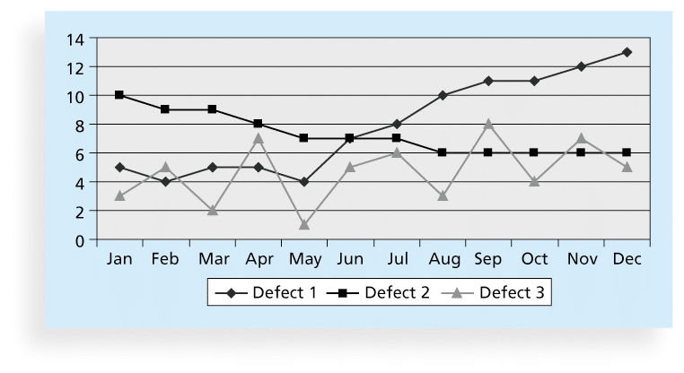
Figure 8-9. Sample Run Chart

Slide 31
Statistical Sampling
Statistical sampling involves choosing part of a population of interest for inspection
The size of a sample depends on how representative you want the sample to be
Sample size formula:
Sample size = .25 X (certainty factor/acceptable error)²
Be sure to consult with an expert when using statistical analysis

Slide 32
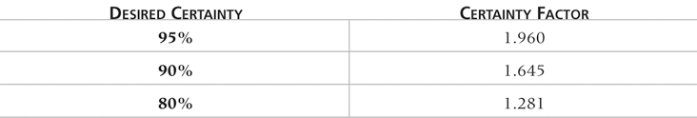
Table 8-1. Commonly Used Certainty Factors

Slide 33
Six Sigma
Six Sigma is “a comprehensive and flexible system for achieving, sustaining, and maximizing business success. Six Sigma is uniquely driven by close understanding of customer needs, disciplined use of facts, data, and statistical analysis, and diligent attention to managing, improving, and reinventing business processes”*
*Pande, Peter S., Robert P. Neuman, and Roland R. Cavanagh, The
Six Sigma Way, New York: McGraw-Hill, 2000, p. xi.

Slide 34
为达到六西格玛的质量性能，需要一组专门的质量改进方法和统计工具。将这些方法和工具教给一小群称为六西格玛黑带的人，他们全职负责定义、测量、分析、改进和控制过程质量。黑带领导跨职能的员工团队（每个人称为六西格玛绿带）来实现过程质量的突破。
六西格玛精英团队确保质量改进项目的重点放在对公司长期的成长和成功影响最大过程上，还通过清除遇到的组织中的障碍来促进改进流程。

Slide 35
一般来讲，包含以下三层含义：
1）是一种质量尺度和追求的目标
2）是一套科学的工具和管理方法，运用 DMAIC（改善）或DFSS（设计）的过程进行流程的设计和改善。
3）是一种经营管理策略。6 Sigma管理是在提高顾客满意程度的同时降低经营成本和周期的过程革新方法，它是通过提高组织核心过程的运行质量，进而提升企业赢利能力的管理方式，也是在新经济环境下企业获得竞争力和持续发展能力的经营策略。

Slide 36
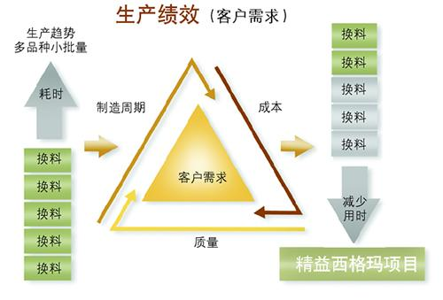

Slide 37
Basic Information on Six Sigma
The target for perfection is the achievement of no more than 3.4 defects per million opportunities
The principles can apply to a wide variety of processes
Six Sigma projects normally follow a five-phase improvement process called DMAIC

Slide 38
DMAIC
DMAIC is a systematic, closed-loop process for continued improvement that is scientific and fact based
DMAIC stands for:
Define: Define the problem/opportunity, process, and customer requirements
Measure: Define measures, then collect, compile, and display data
Analyze: Scrutinize process details to find improvement opportunities
Improve: Generate solutions and ideas for improving the problem
Control: Track and verify the stability of the improvements and the predictability of the solution

Slide 39
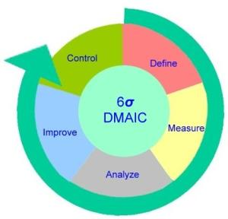
DMAIC模型是实施6sigma的一套操作方法。DMAIC是6σ管理中最重要、最经典的管理模型，主要侧重在已有流程的质量改善方面。

Slide 40
How is Six Sigma Quality Control Unique?
It requires an organization-wide commitment.
Training follows the “Belt” system
Six Sigma organizations have the ability and willingness to adopt contrary objectives, such as reducing errors and getting things done faster
It is an operating philosophy that is customer focused and strives to drive out waste, raise levels of quality, and improve financial performance at breakthrough levels

Slide 41
What Went Right?
Motorola, Inc. pioneered the adoption of Six Sigma in the 1980s and saved about $14 billion
Allied Signal/Honeywell saved more than $600 million a year by reducing the costs of reworking defects and improving aircraft engine design processes
After implementing the solutions recommended by a Six Sigma team for Baptist St. Anthony's Hospital in Amarillo, Texas, the percent of delayed cases in the radiology department dropped from 79 percent to 33 percent, delays decreased by 22 percent, and the number of orders missing or needing clarification dropped to zero from 11 percent

Slide 42
Six Sigma and Project Management
Joseph M. Juran stated, “All improvement takes place project by project, and in no other way”*
It’s important to select projects carefully and apply higher quality where it makes sense; companies that use Six Sigma do not always boost their stock values
As Mikel Harry puts it, “I could genetically engineer a Six Sigma goat, but if a rodeo is the marketplace, people are still going to buy a Four Sigma horse.”**
Six Sigma projects must focus on a quality problem or gap between the current and desired performance and not have a clearly understood problem or a predetermined solution
*“What You Need to Know About Six Sigma,” Productivity Digest (December 2001), p. 38.
**Clifford, Lee, “Why You Can Safely Ignore Six Sigma,” Fortune (January 22, 2001), p. 140.

Slide 43
Six Sigma Projects Use Project Management
The training for Six Sigma includes many project management concepts, tools, and techniques
For example, Six Sigma projects often use business cases, project charters, schedules, budgets, and so on
Six Sigma projects are done in teams; the project manager is often called the team leader, and the sponsor is called the champion

Slide 44
Six Sigma and Statistics
The term sigma means standard deviation
Standard deviation measures how much variation exists in a distribution of data
Standard deviation is a key factor in determining the acceptable number of defective units found in a population
Six Sigma projects strive for no more than 3.4 defects per million opportunities, yet this number is confusing to many statisticians

Slide 45
Six Sigma Uses a Conversion Table
Using a normal curve, if a process is at six sigma, there would be no more than two defective units per billion produced
Six Sigma uses a scoring system that accounts for time, an important factor in determining process variations
Yield represents the number of units handled correctly through the process steps
A defect is any instance where the product or service fails to meet customer requirements
There can be several opportunities to have a defect

Slide 46
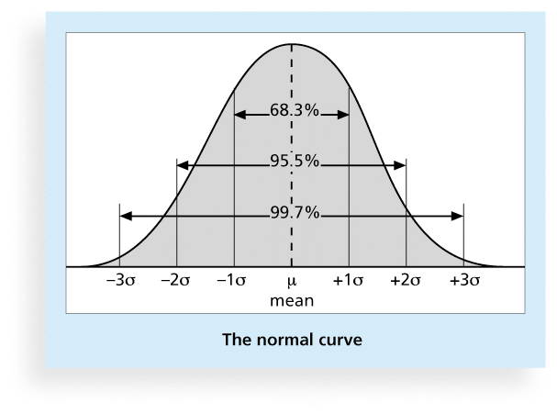
Figure 8-10. Normal Distribution and Standard Deviation

Slide 47
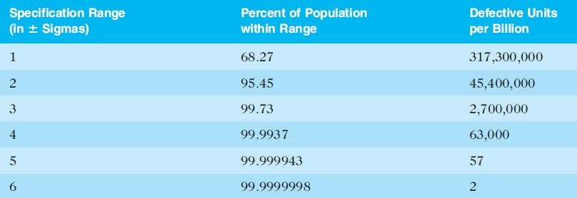
Table 8-2. Sigma and Defective Units

Slide 48
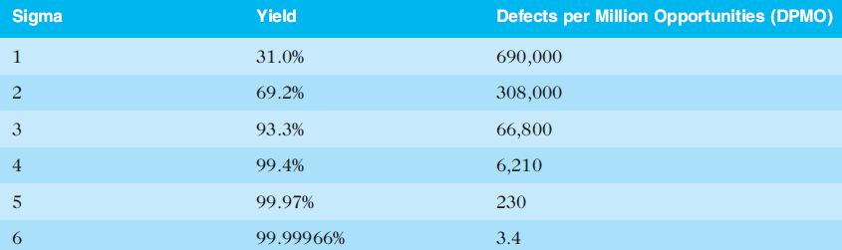
Table 8-3: Sigma Conversion Table

Slide 49
Six 9s of Quality
Six 9s of quality is a measure of quality control equal to 1 fault in 1 million opportunities
In the telecommunications industry, it means 99.9999 percent service availability or 30 seconds of down time a year
This level of quality has also been stated as the target goal for the number of errors in a communications circuit, system failures, or errors in lines of code

Slide 50
六西格玛软件Minitab
Minitab 1972年成立于美国的宾夕法尼亚大学，到目前为止，已经在全球100多个国家，4800多所高校被广泛使用。
Minitab最新版本是Minitab16，于2010年初发布，内置“协助”功能，为使用者提供更完善的使用和精确的分析思路。Minitab软件是现代质量管理统计的专用软件，全球六西格玛实施的共同语言，以强大功能和简易的可视化操作深受广大质量学者和统计专家的喜爱。
典型的客户有：GE、福特汽车、通用汽车、3M、霍尼韦尔、LG、东芝、诺基亚、宝钢、徐工集团、海尔、中国航天集团、中铁、中国建设银行、美洲银行、上海世茂皇家艾美酒店、浦发银行、太平人寿、北大光华学院、中欧国际工商学院、华中科大、武汉理工、华东理工、西交利物浦大学等。

Slide 51
六西格玛组织结构
6σ管理需要一套合理、高效的人员组织结构来保证改进活动得以顺利实现。在过去，之所以有80%的全面质量管理（Total Quality Management，TQM）实施者失败，最大原因就是缺少这样一个人员组织结构。
执行负责人
六西格玛6σ管理的执行负责人由一位副总裁以上的高层领导担任。这是一个至关重要的职位，要求具有较强的综合协调能力的人才能胜任。其具体职责是：为项目设定目标、方向和范围；协调项目所需资源；处理各项目小组之间的重叠和纠纷，加强项目小组之间的沟通等。
绿带（Green Belt）
绿带的工作是兼职的，他们经过培训后，将负责一些难度较小项目小组，或成为其他项目小组的成员。

Slide 52
黑带（Black Belt）
黑带来源于军事术语，指那些具有精湛技艺和本领的人。黑带是6σ变革的中坚力量。对黑带的认证通常由外部咨询公司配合公司内部有关部门来完成。黑带由企业内部选拔出来，全职实施6σ管理，在接受培训取得认证之后，被授予黑带称号，担任项目小组负责人，领导项目小组实施流程变革，同时负责培训绿带。黑带的候选人应该具备大学数学和定量分析方面的知识基础，需要具有较为丰富的工作经验。
黑带大师
这是6σ管理专家的最高级别，其一般是统计方面的专家，负责在6σ管理中提供技术指导。

Slide 53
Testing
Many IT professionals think of testing as a stage that comes near the end of IT product development
Testing should be done during almost every phase of the IT product development life cycle

Slide 54
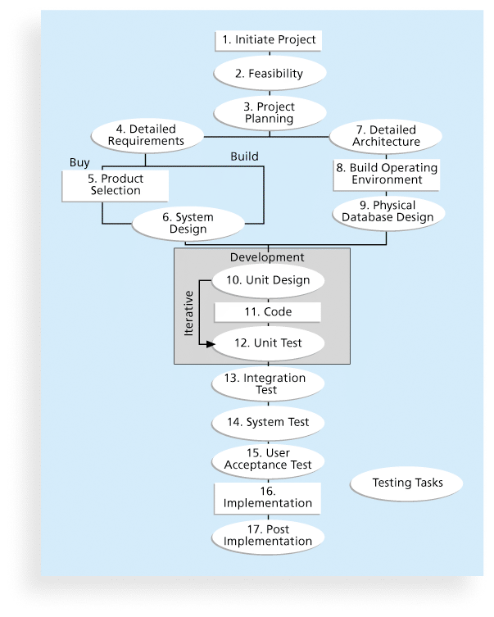
Figure 8-11. Testing Tasks in the Software Development Life Cycle

Slide 55
Types of Tests
Unit testing tests each individual component (often a program) to ensure it is as defect-free as possible
Integration testing occurs between unit and system testing to test functionally grouped components
System testing tests the entire system as one entity
User acceptance testing is an independent test performed by end users prior to accepting the delivered system

Slide 56
Testing Alone Is Not Enough
Watts S. Humphrey, a renowned expert on software quality, defines a software defect as anything that must be changed before delivery of the program
Testing does not sufficiently prevent software defects because:
The number of ways to test a complex system is huge
Users will continue to invent new ways to use a system that its developers never considered
Humphrey suggests that people rethink the software development process to provide no potential defects when you enter system testing; developers must be responsible for providing error-free code at each stage of testing

Slide 57
Modern Quality Management
Modern quality management:
Requires customer satisfaction
Prefers prevention to inspection
Recognizes management responsibility for quality
Noteworthy quality experts include Deming, Juran, Crosby, Ishikawa, Taguchi, and Feigenbaum

Slide 58
Quality Experts
Deming was famous for his work in rebuilding Japan and his 14 Points for Management
Juran wrote the Quality Control Handbook and ten steps to quality improvement
Crosby wrote Quality is Free and suggested that organizations strive for zero defects
Ishikawa developed the concepts of quality circles and fishbone diagrams
Taguchi developed methods for optimizing the process of engineering experimentation
Feigenbaum developed the concept of total quality control

Slide 59
Malcolm Baldrige Award
The Malcolm Baldrige National Quality Award originated in 1987 to recognize companies that have achieved a level of world-class competition through quality management
Given by the President of the United States to U.S. businesses
Three awards each year in different categories:
Manufacturing
Service
Small business
Education and health care

Slide 60
ISO Standards
ISO 9000 is a quality system standard that:
Is a three-part, continuous cycle of planning, controlling, and documenting quality in an organization
Provides minimum requirements needed for an organization to meet its quality certification standards
Helps organizations around the world reduce costs and improve customer satisfaction
See www.iso.org for more information

Slide 61
Global Issues
Many car manufacturers are proud to show and sell their electric cars (Audi, Cadillac, Chevrolet, etc.), but many people might wonder if these cars are safe
Fortunately, ISO has updated a standard on safety features in electric and hybrid cars to prevent electricity-related injuries
ISO 6469-3:2011, Electrically propelled road vehicles – protection of persons against electric shock, will help the global market for electric cars

Slide 62
Improving Information Technology Project Quality
Several suggestions for improving quality for IT projects include:
Establish leadership that promotes quality
Understand the cost of quality
Focus on organizational influences and workplace factors that affect quality
Follow maturity models

Slide 63
Leadership
As Joseph M. Juran said in 1945, “It is most important that top management be quality-minded. In the absence of sincere manifestation of interest at the top, little will happen below”*
A large percentage of quality problems are associated with management, not technical issues.
*American Society for Quality (ASQ), (www.asqc.org/about/history/juran.html).

Slide 64
The Cost of Quality
The cost of quality is the cost of conformance plus the cost of nonconformance
Conformance means delivering products that meet requirements and fitness for use
Cost of nonconformance means taking responsibility for failures or not meeting quality expectations
A study reported that software bugs cost the U.S. economy $59.6 billion each year and that one third of the bugs could be eliminated by an improved testing infrastructure

Slide 65
Five Cost Categories Related to Quality
Prevention cost: Cost of planning and executing a project so it is error-free or within an acceptable error range
Appraisal cost: Cost of evaluating processes and their outputs to ensure quality
Internal failure cost: Cost incurred to correct an identified defect before the customer receives the product
External failure cost: Cost that relates to all errors not detected and corrected before delivery to the customer
Measurement and test equipment costs: Capital cost of equipment used to perform prevention and appraisal activities

Slide 66
Media Snapshot
A 2007 study by Nucleus Research Inc. estimated that spam management costs U.S. businesses more than $71 billion annually in lost productivity or $712 per employee
One e-mail security firm estimated that spam accounts for 95 percent of total e-mail volume worldwide
In 2008, Reuters reported that spyware and phishing cost consumers $7.1 billion in 2007, up from $2 billion the previous year
A 2011 report estimated that “10% of Americans have had their identities stolen, and on average, each of those individuals lost around $5,000. The cost to businesses worldwide adds up to a staggering $221 billion each year.”

Slide 67
Organizational Influences, Workplace Factors, and Quality
Study by DeMarco and Lister showed that organizational issues had a much greater influence on programmer productivity than the technical environment or programming languages
Programmer productivity varied by a factor of one to ten across organizations, but only by 21 percent within the same organization
Study found no correlation between productivity and programming language, years of experience, or salary.
A dedicated workspace and a quiet work environment were key factors to improving programmer productivity

Slide 68
Expectations and Cultural Differences in Quality
Project managers must understand and manage stakeholder expectations.
Expectations also vary by:
Organization’s culture
Geographic regions

Slide 69
Maturity Models
Maturity models are frameworks for helping organizations improve their processes and systems
The Software Quality Function Deployment Model focuses on defining user requirements and planning software projects
The Software Engineering Institute’s Capability Maturity Model Integration is a process improvement approach that provides organizations with the essential elements of effective processes

Slide 70
CMMI Levels
CMMI levels, from lowest to highest, are:
Incomplete
Performed
Managed
Defined
Quantitatively Managed
Optimizing
Companies may not get to bid on government projects unless they have a CMMI Level 3

Slide 71
PMI’s Maturity Model
PMI released the Organizational Project Management Maturity Model (OPM3) in December 2003
Model is based on market research surveys sent to more than 30,000 project management professionals and incorporates 180 best practices and more than 2,400 capabilities, outcomes, and key performance indicators
Addresses standards for excellence in project, program, and portfolio management best practices and explains the capabilities necessary to achieve those best practices

Slide 72
Best Practice
OPM3 provides the following example to illustrate a best practice, capability, outcome, and key performance indicator:
Best practice: Establish internal project management communities
Capability: Facilitate project management activities
Outcome: Local initiatives, meaning the organization develops pockets of consensus around areas of special interest
Key performance indicator: Community addresses local issues

Slide 73
Using Software to Assist in Project Quality Management
Spreadsheet and charting software helps create Pareto diagrams, fishbone diagrams, and so on
Statistical software packages help perform statistical analysis
Specialized software products help manage Six Sigma projects or create quality control charts
Project management software helps create Gantt charts and other tools to help plan and track work related to quality management

Slide 74
Chapter Summary
Project quality management ensures that the project will satisfy the needs for which it was undertaken
Main processes include:
Plan quality
Perform quality assurance
Perform quality control

